Slide 1

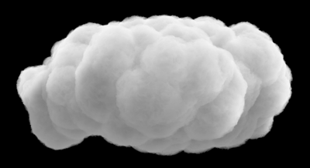
In search of big radar data, model output, pollen and station data for the prediction of pollen counts in Richmond using ML techniques (science: it’s the journey)
UR data analytics bootcamp final project
Marie c. Colton, Ph.D.
15 jan 2020

Slide 2
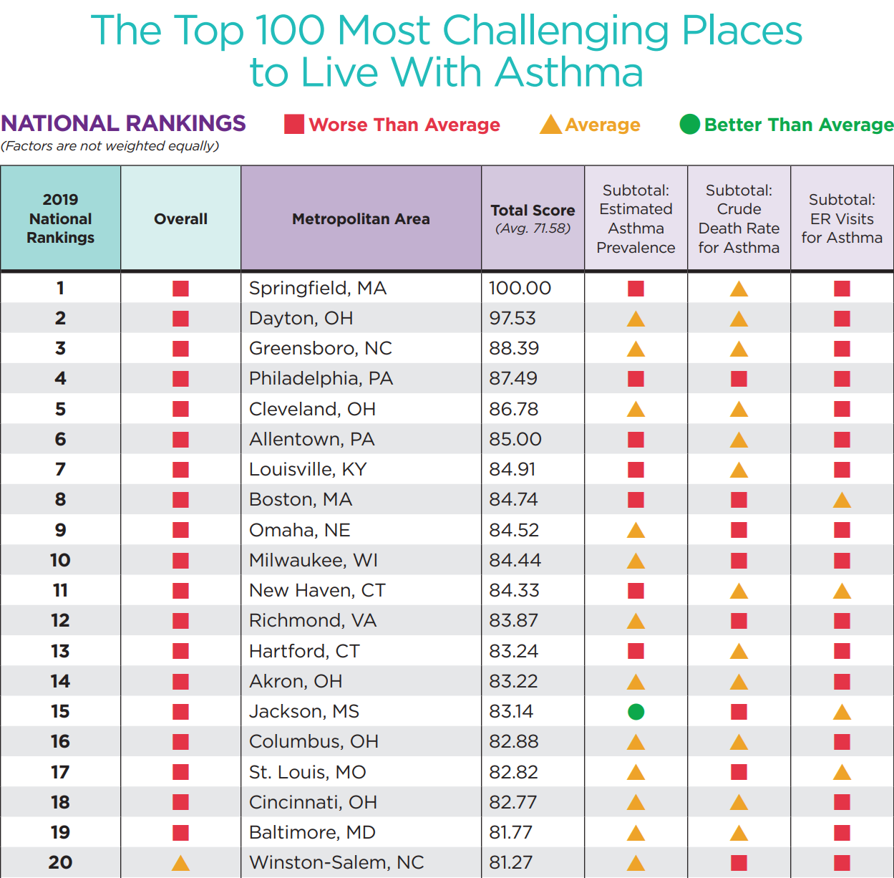
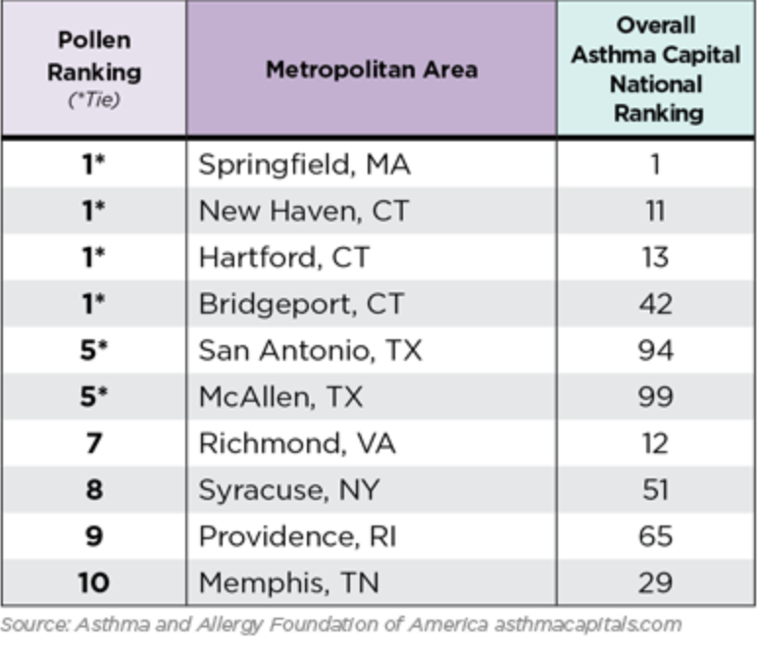
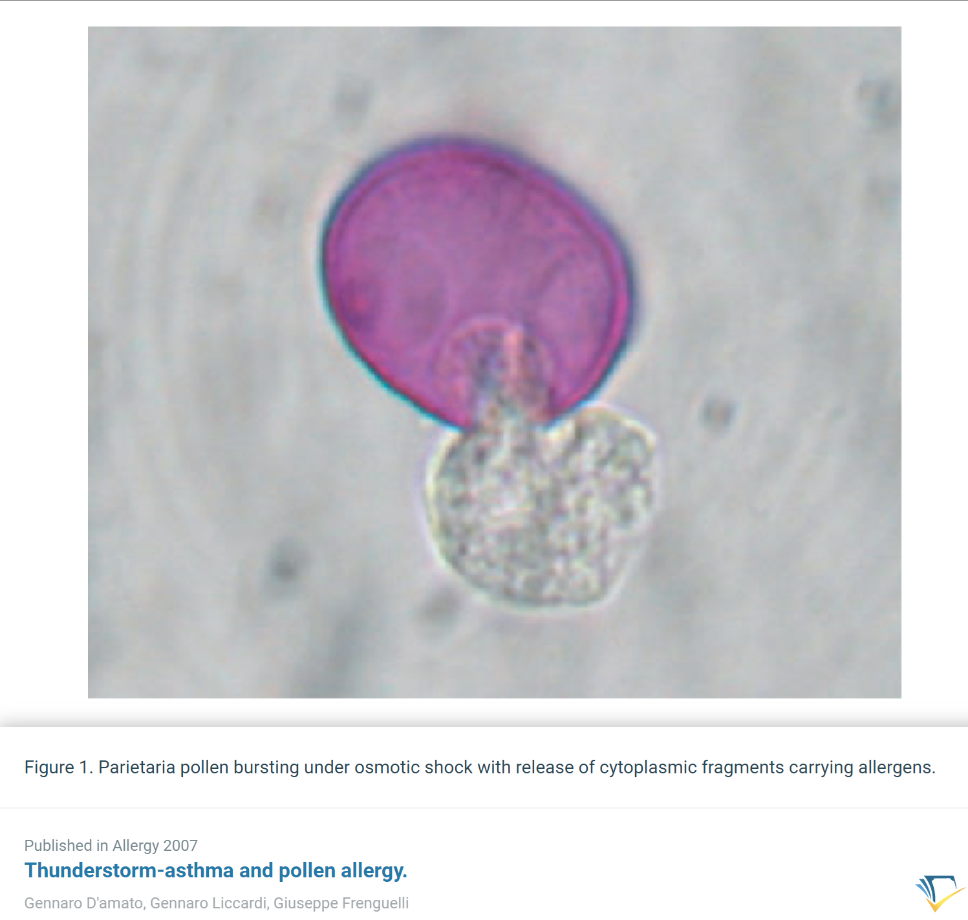
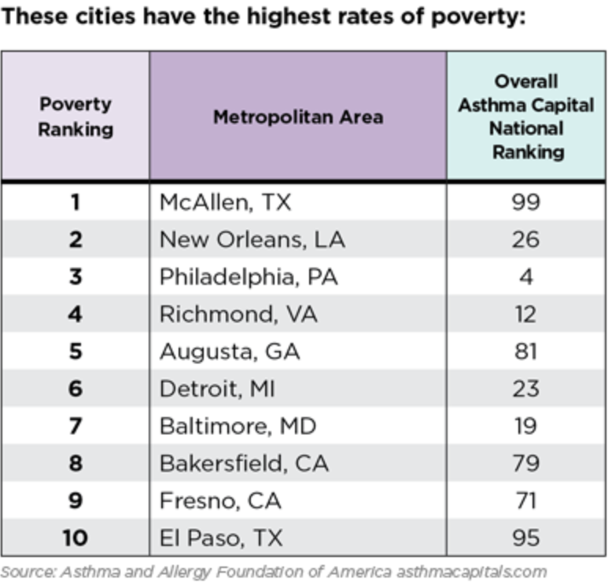
Project Motivation linkage between weather and asthma
# 12
Asthma capitals report 2019

Slide 3
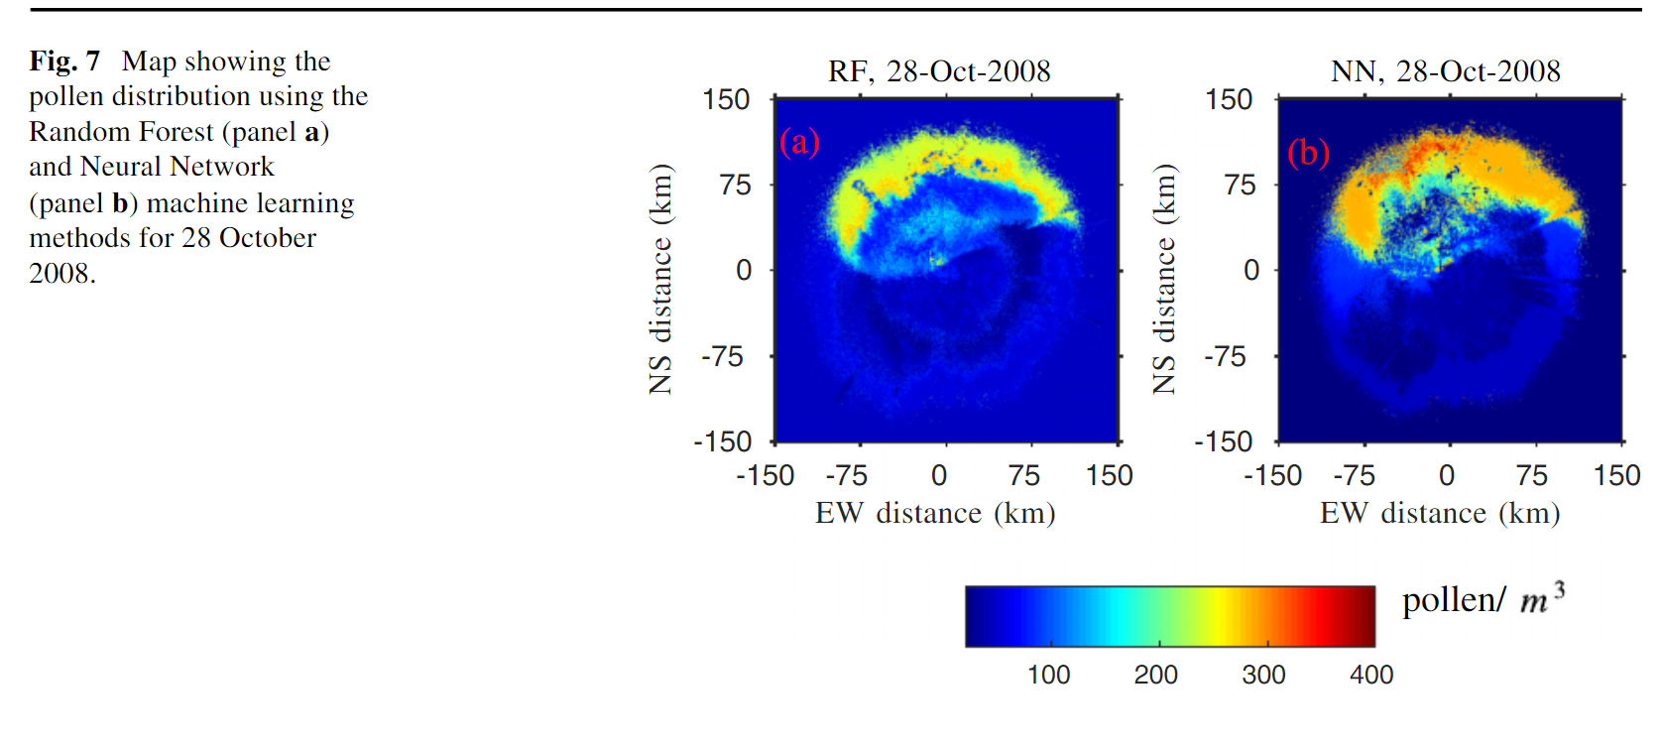
Thunderstorm asthma
Thunderstorm-triggered asthma (TA) is the occurrence of acute asthma attacks immediately following a thunderstorm.
NEXRAD radar measurements of reflectivity, line of sight Doppler velocity, spectral width at the lowest two elevations, direction and speed of wind, and machine learning to estimate the daily Ambrosia pollen at the University of Tulsa, Oklahoma.
“An early warning system based on environmental factors to alert emergency services and allow communication to at-risk individuals is necessary; however, it is difficult to implement given an unacceptably high false alarm rate currently.”
Harun, Nur-Shirin et al. “Thunderstorm-triggered asthma: what we know so far.” Journal of asthma and allergy vol. 12 101-108. 6 May. 2019, doi:10.2147/JAA.S175155
Zewdie, Gebreab & Lary, David & Wu, Daji & Liu, Xun & Levetin, Estelle. (2019). Estimating the Daily Pollen Concentration in the Atmosphere Using Machine Learning and NEXRAD Weather Radar Data. Environmental Monitoring and Assessment. 191. 10.1007/s10661-019-7542-9.

Slide 4

Target data set: Pollen
Does Richmond have regular measurements of pollen counts freely available?
After some sleuthing… yes… from Allergy Partners of Richmond (Rebecca Collie), shared by the Science Museum of Virginia (Dr. Jeremy Hoffman, Chief scientist)
Every morning, M-F, at about 11 AM for the past 30 years
2017. CHARACTERIZING 30 YEARS OF TREE, MOLD, AND GRASS POLLEN DATA FROM RICHMOND, VA. Rebecca Collie¹, Jeremy S. Hoffman², E.G. Maurakis² and J.M. Scanlon², ¹Allergy Partners of Richmond 23229 and ²Science Museum of Virginia, Richmond, VA 23220. Virginia Academy of Science Annual Meeting, MAY.

Slide 5
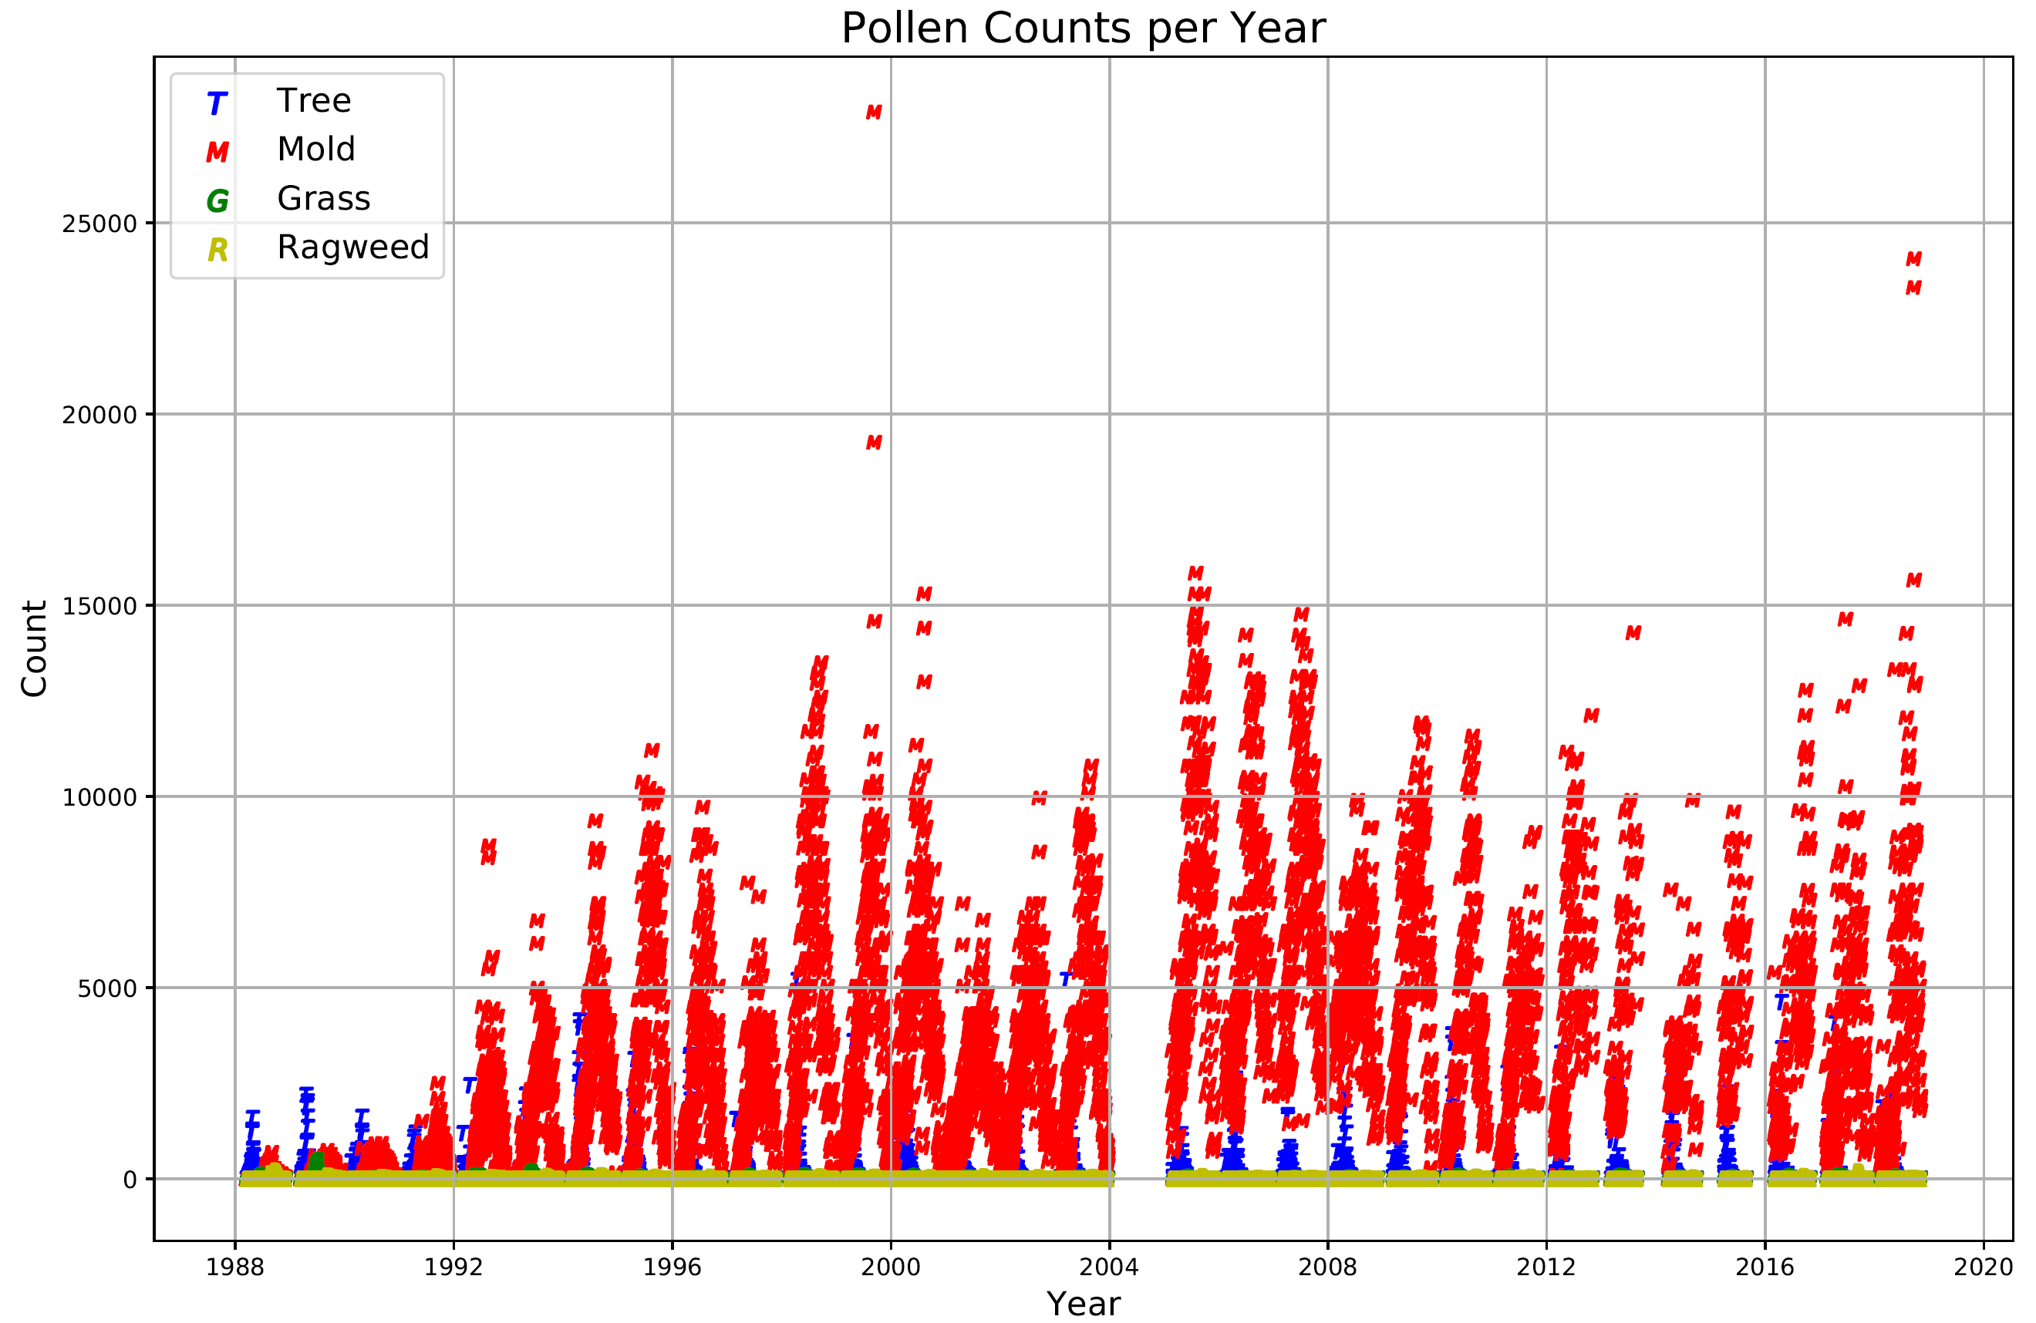
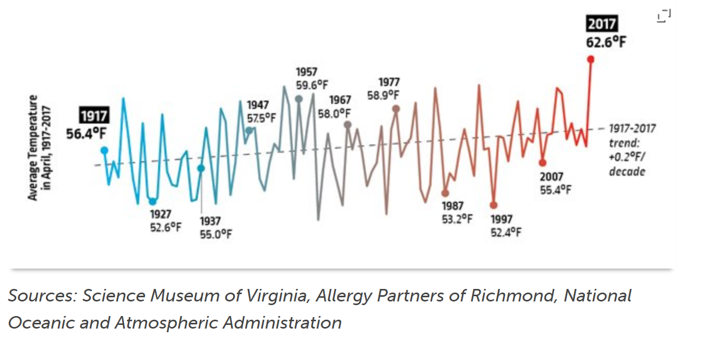
Thirty years of counts and April average temperature

Slide 6
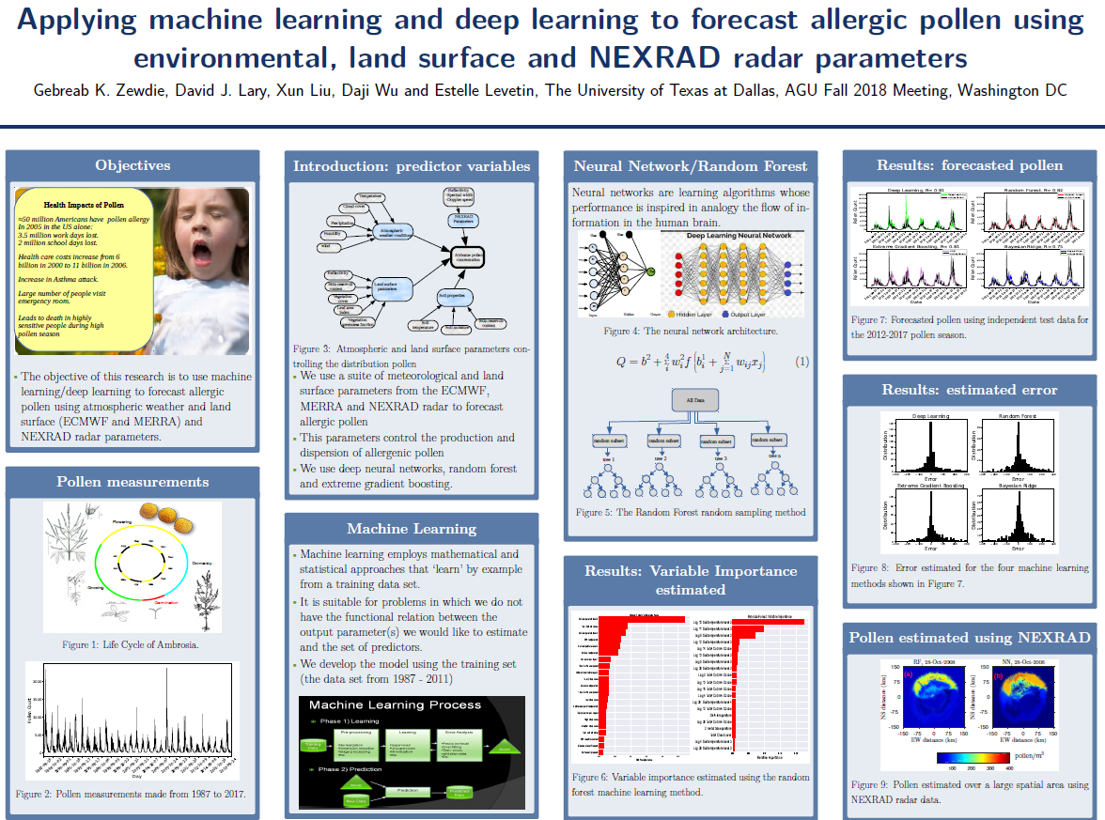
Technical approach #1 the whole enchilada
Download NEXRAD data from Richmond radar during spring months and severe storms from Google or AWS and process to images
Look for high reflectivity or edges associated with thunderstorms using ML pattern recognition
Train NN with pollen data if available, else..

Slide 7
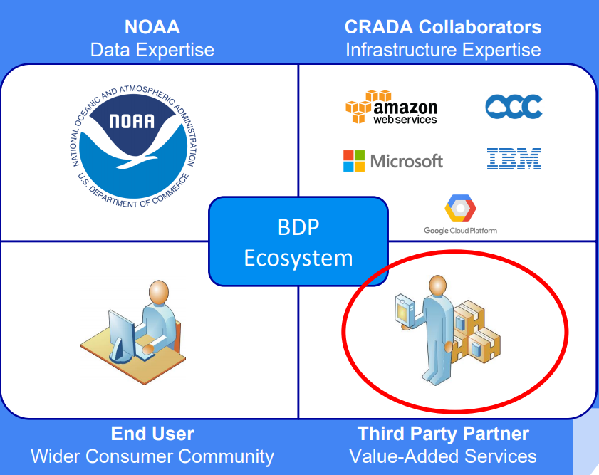
NOAA big data project collaborators
Amazon Web Services
NEXRAD complete radar data
GOES-16 imagery
IBM NOAA Earth Systems Portal
Rapid Refresh (RAP) high resolution model output
NOAA Fisheries Trawl, Observer, Habitat data
(portal doesn’t seem to be working)
Google Cloud Platform
“access and usability” part of Google public data mission
NOAA, USGS, EPA, ESA
Also some social media data sets
Microsoft
AI for Earth
Open Commons Consortium
Open Science Data Cloud is a “datascope” for modern research
Large university membership, not private sector (UVA and VCU are members, UR is not)
Can a data scientist entrepreneur easily access and use these data economically for new analytical products?

Slide 8

Initial exploration of noaa “big data” site
Results
Libraries needed
Initial download of “KAKQ” Richmond radar yielded very large data files (>25Mb) for single scan and elevation
Geographical re-mapping to pollen measurement site needed to be completed (not clear what the author of the paper used to do this and needs more analysis)
Full data set required for analysis would need to stay “in the cloud”
Jupyter Notebook also up to the cloud, therefore, provisioning of AWS Elastic Compute Cloud (EC2) for running ETL pipeline
Must determine the cost implications before using “free services”
Import nexradaws (repo library for accessing AWS radar data)
Import pyart (repo for R/W manipulation of radar data files and plotting azimuthal maps of reflectivity)
Import MetPy for computation of weather variables
Import cartopy for certain mapping capabilities
$$$

Slide 9
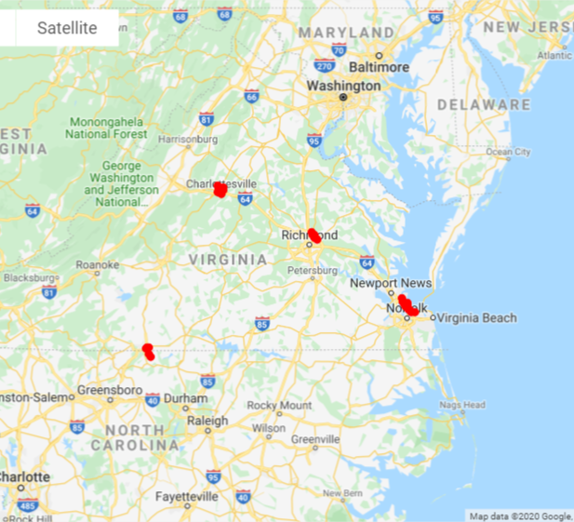
Technical approach #2 one byte at a time
Approximate spatial dimension using local weather data for 20-year period from Weather Forecast Offices surrounding Richmond (from NOAA Climate Data Center, Asheville)
Add indicator index, Standardized Precipitation Index (SPI), for proxy soil moisture
Assume “collocation” of observations with Richmond pollen site (groupby stations within reasonable distance)
Interpolate weekly SPI data to daily measurements
Merge on day to pollen data
Evaluate various supervised learning algorithms

Slide 10
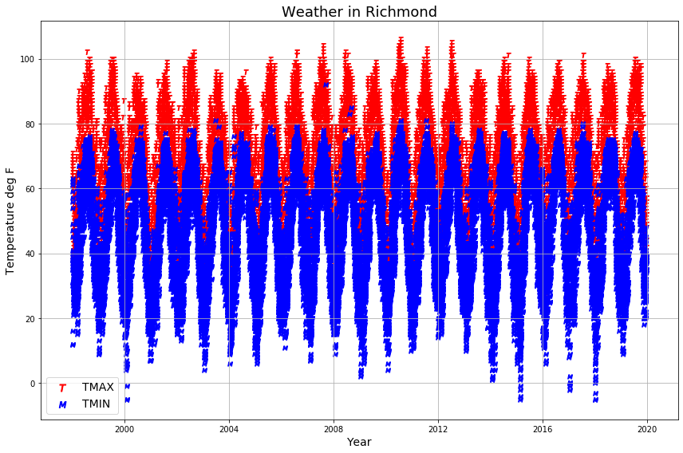
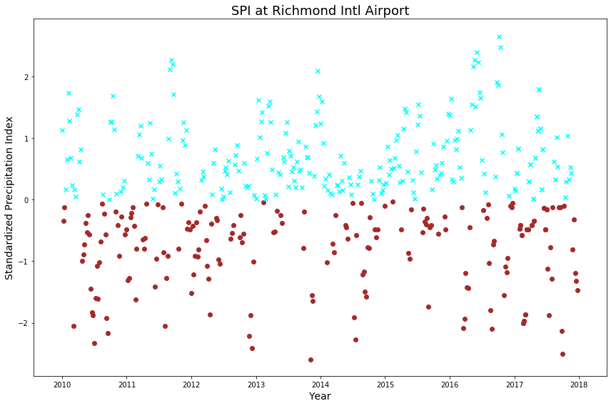
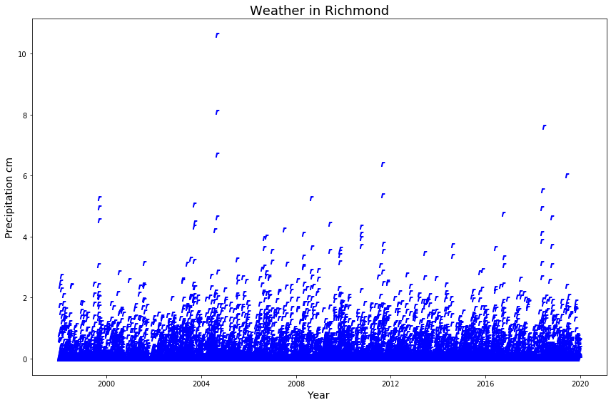
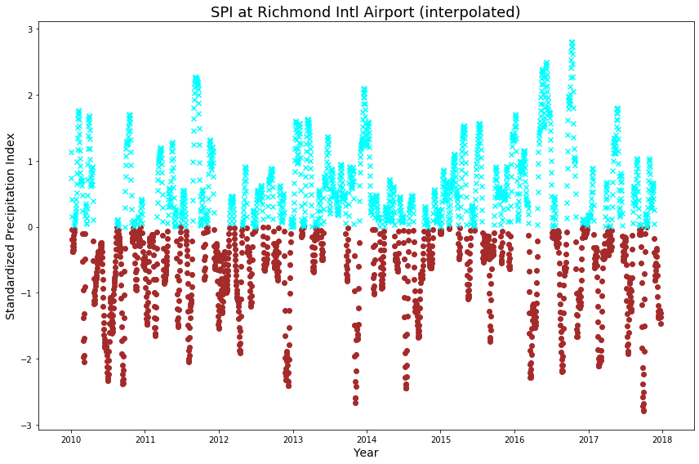
Data munging 1 Richmond data only
Does “soil moisture” index add value to the weather and pollen data?
Interpolate Standardized Precip Index to daily values
Remove incomplete wx records
Groupby day and merge 2010 – 2019 data of SPI to pollen and weather data
Reduces data records from original 54K to only 1K

Slide 11
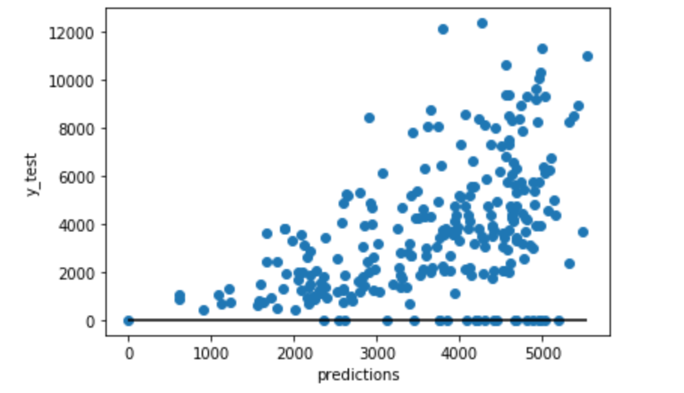
Execute ML techniques using reduced data set
Merged data is a multivariate set of weather and SPI variables with pollen as the target
Continuous variables regressed on pollen implies use of supervised multiple regression machine learning algorithm
Only 1061 data records, low R-squared
Get more data…
Mean Squared Error (MSE): 5705657.256145541
R-squared (R2 ): 0.22972981720914487

Slide 12
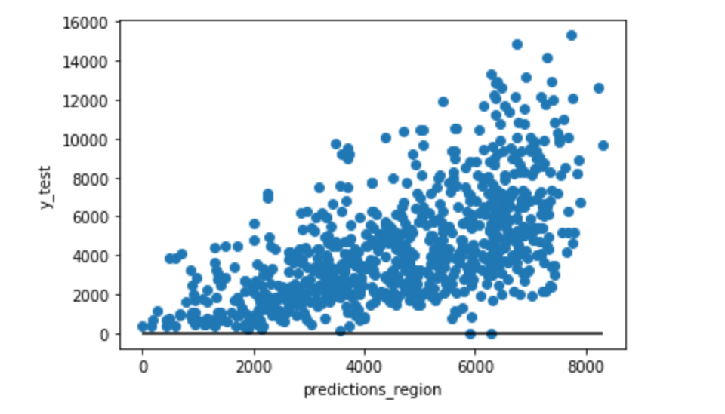
Data Munging 2 Retrieve more data and repeat regression
Does adding more basic wx data help robustness?
Drop SPI values
Add station data from Hampton (East), Danville (SW), and Charlottesville (NW)
Remove incomplete records
Groupby stations
Merge on date
Total number of records increases to 3902
Multiple regression using all station data and including mold in the feature set
Mean Squared Error (MSE): 5153732.546301785
R-squared (R2 ): 0.3517249619599787

Slide 13
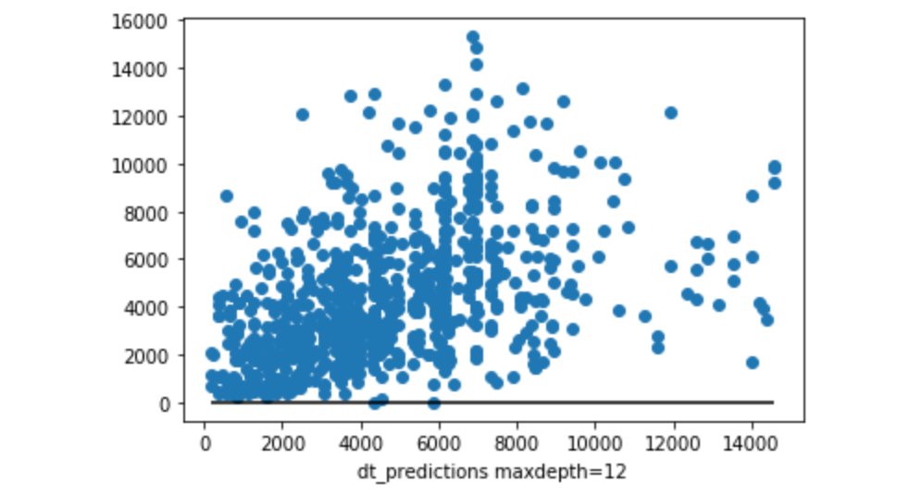
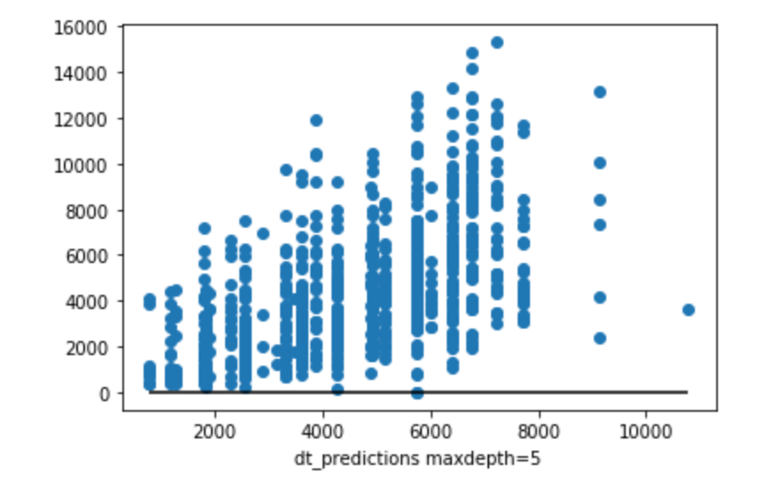
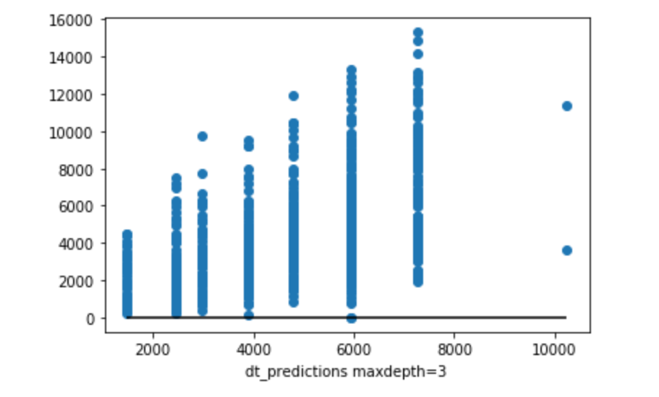
Decision tree regression to improve score?
R-squared (R2 ): -0.08422471274139864
overfitting
Mean Squared Error (MSE): 5521710.520577297 R-squared (R2 ): 0.3054379392772578
R-squared (R2 ): 0.31572134949382114

Slide 14
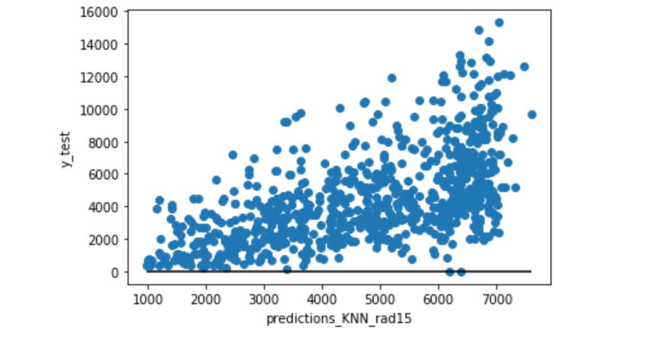
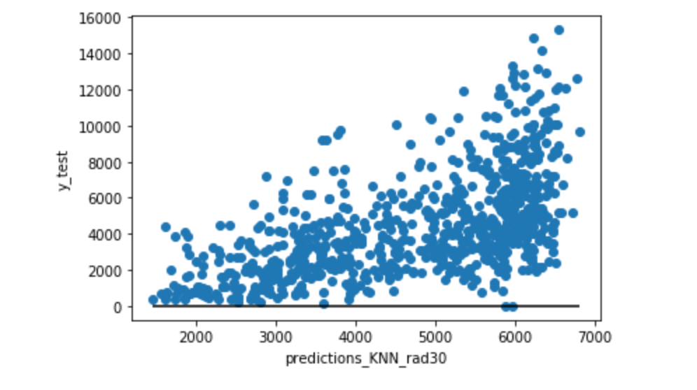
K-Nearest Neighbor regression to improve score? The label assigned to a query point is computed based on the mean of the labels of its nearest neighbors.
Mean Squared Error (MSE): 5226997.472351271
R-squared (R2 ): 0.3425091514197496
Scatter of predictions to y_test is closer to 1:1
Mean Squared Error (MSE): 5377963.056491521
R-squared (R2 ): 0.3235

Slide 15
Final comments
Project understanding
Machine Learning
Annual cycle of pollen counts are modified by seasonal weather events that can be observed using radar and station data
Machine learning algorithms using “zero-th order” simple data set of average temperature, precipitation, and wind show small positive correlation with pollen counts, encouraging further examination
Inclusion of radar data, and a weather model suite of parameters for Richmond area could yield a regional algorithm for prediction of pollen counts for eventual use as an “early warning system”
Applied numerical analysis and language processing techniques are codified in the sk-learn and tensor flow libraries as “machine learning”
The libraries offer the user a rapid and validated approach for examination of complex and not always visible relationships between “features” and “targets” in very large data sets
Care must be taken to understand the theoretical and mathematical basis for each of the algorithms in order to apply the technique correctly and accurately interpret the results

Slide 16
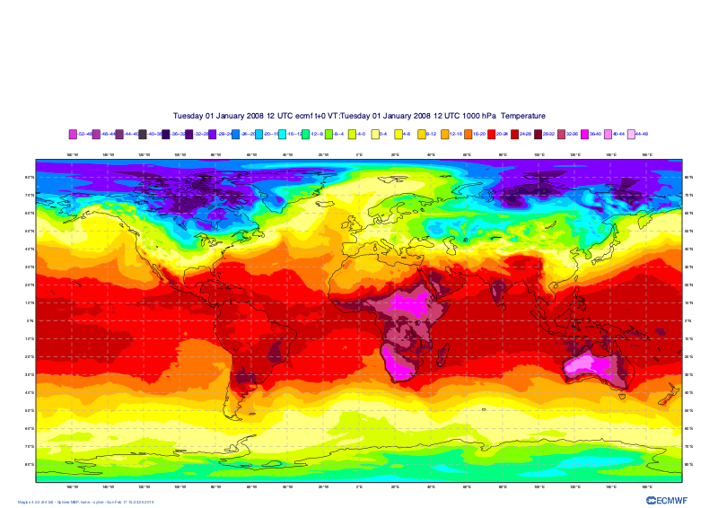
future work digest the rest of the enchilada
Complete the AWS download and analysis of radar data to develop competence in the full workflow and ML to pollen algorithm
Download European Center for Medium-range Weather Forecasting (ECMWF) weather model data for full set of features to associate with pollen data
“Match” gridded data to Richmond location
Train NN with pollen data
Connect to Laura Dobbs, Microsoft AI for Earth Program Manager to get NIH health records for Richmond

Slide 17
background

Slide 18
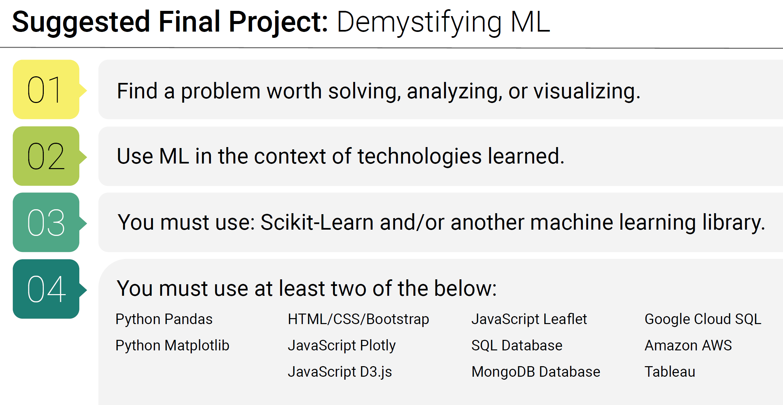
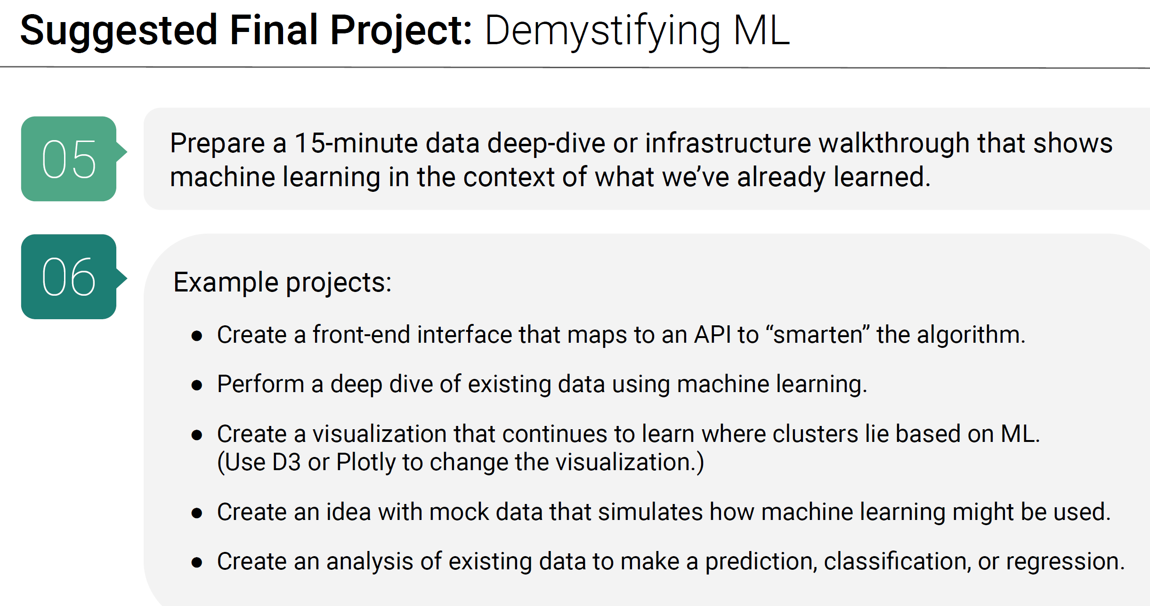
Project requirements

